Slide 1
Algorithm Design Approaches
18ESC108A Elements of Computer Science and Engineering
B. Tech. 2018
Ami Rai E.
Roopa G
Chaitra S
Department of Computer Science and Engineering
Faculty of Engineering and Technology
Ramaiah University of Applied Sciences

Slide 2
Objectives
At the end of this lecture, student will be able to
Identify the practice of Brute force approach
Identify the practice of Greedy approach
Explain divide and conquer approach to algorithm design
Explain reduce and conquer approach to solving problems
Understand Backtracking and Dynamic programming

Slide 3
Topics
Brute force approach
Greedy approach
Divide and conquer approach
Reduce and Conquer approach
Backtracking
Dynamic programming

Slide 4

“If all you have is a hammer, everything looks like a nail”
- Abraham Marslow

Slide 5
Approaches
We have seen several algorithms till now
Q. Are there any common ways to design algorithms?
A. Yes
Major algorithmic approaches
Brute Force
Greedy Techniques
Divide and Conquer
Back Tracking
Dynamic Programming

Slide 6
Brute Force Approach
Solves a problem in the most simple, direct, or obvious way not distinguished by structure or form
Often simple to implement
May do more work than necessary –May be efficient (but typically is not)

Slide 7

Pattern Matching Example
Text
Pattern
Applications
Search Engines
Word Processors
Genetic Engineering

Slide 8
Brute Force Algorithm
Text
Pattern

Slide 9
Example: Counting Change
Problem Definition:
Cashier has collection of ‘coins’ of various denominations
Goal is to return a specified sum using the smallest number of coins

Slide 10
Problem: Mathematical definition
Mathematical Definition:
n coins: P = {p1, p2, p3, …, pn} with value D = {d1, d2, d3, …, dn}
can have repetition (two dimes, three pennies)
S is a subset of P, S ⊆ P, such that si = 1 if pi ∈ S, si = 0 if pi ∉ S
A: sum to be returned
Goal: minimize Σsi, such that Σdi = A

Slide 11
Change Making - Example
How should a payment counter make change using the least number of notes/coins?
To make Rs. 488
4 x 100
1 x 50
1 x 20
1 x 10
1 x 5
1 x 2
1 x 1

Slide 12
Brute Force Approach
Try all subsets of P
since there are n coins, there are 2n possible subsets
Eenumerate all possible subsets
Check if a subset equals A called ‘feasible solution’ set, O( n)
Pick subset that minimizes Σsi called ‘objective function’ O( n)

Slide 13
Why Brute Force Approach?
Brute Force is the worst algorithm for any problem
Then, why study it?
Applicable to almost all problems
It leads to simple algorithms
It is a good starting point for developing more efficient algorithms
It is the standard algorithm for several problems
Exhaustive Search
Graph Traversal
Caution
Brute force algorithms can be unreasonably slow
E.g., Recursive Fibonacci sequence computation

Slide 14
Greedy Approach
Algorithm that makes sequence of decisions, and never reconsiders decisions that have been made
May run significantly faster than brute-force
May not lead to correct/optimal solution
Chang Making
Go from largest to smallest denomination – Return largest coin pi from P, such that di ≤ A –A = A – di –Find next largest coin …
If money is sorted (by value), then algorithm is O(n)

Slide 15
Change Making – Example
How should a payment counter make change using the least number of notes/coins?
To make Rs. 488
4 x 100
1 x 50
1 x 20
1 x 10
1 x 5
1 x 2
1 x 1
If 20 notes are not available?
4 x 100
1 x 50
3 x 10
1 x 5
1 x 2
1 x 1

Slide 16
Brute Force and Greedy Approaches
Brute-force:
solve problem in simplest way
generate entire solution set, pick best
will give optimal solution with (typically) poor efficiency
Greedy:
make local, best decision, and don’t look back
may give optimal solution with (typically) ‘better’ efficiency
depends upon ‘greedy-choice property’

Slide 17
Divide and Conquer Approach
Divide Phase
Divide the problem into roughly equal sized sub-problems
Recursively, down to the smallest size
Conquer Phase
Solve the sub-problems independently
Merge the solutions

Slide 18
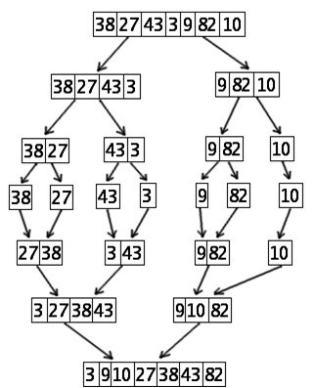
Merge Sort

Slide 19
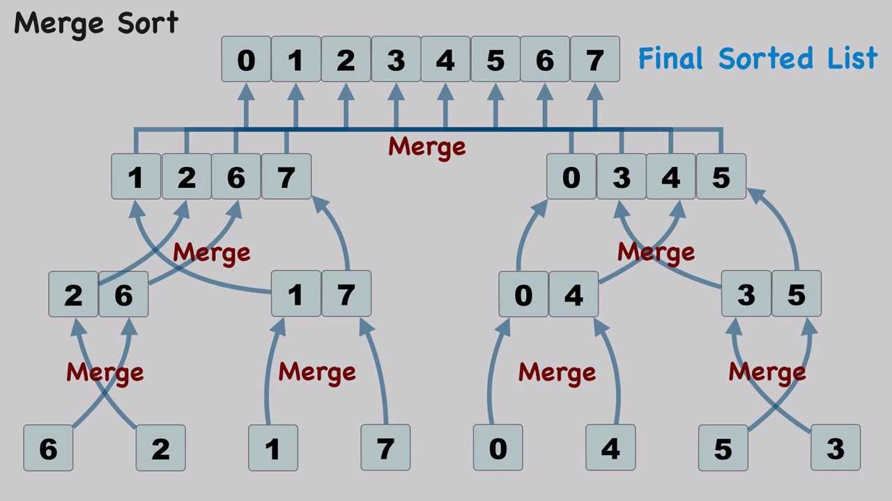
Merge Algorithm

Slide 20
Merge Sort Algorithm
Divide the array into two equal parts
Recursively merge sort the left part of the array
Recursively merge sort the right part of the array
Merge the sorted left and the right part into a single sorted vector using Merge Algorithm

Slide 21
Reduce and Conquer
Divide into sub-problems
Conquer
Decision: Select the sub-problem to be solved
Solve the sub-problem
Example: Binary Search
Divide the sorted array into (almost) equal parts
Conquer
Have we found the item?
If no, choose left or right part of the array to search

Slide 22
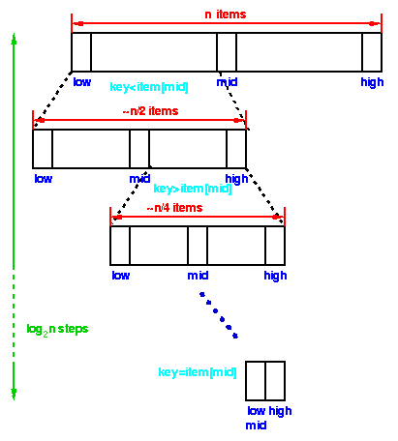
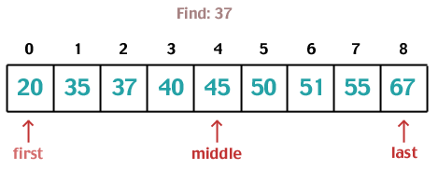
Binary Search

Slide 23
Binary Search Algorithm
Observation:
At each stage we are solving
only one of the sub-problems!
So, we are conquering by reducing the problem!
Complexity?
= No of decisions/steps
= log n (How?)

Slide 24
Introduction to Backtracking
Suppose you have to make a series of decisions, among various choices, where
You don’t have enough information to know what to choose
Each decision leads to a new set of choices
Some sequence of choices (possibly more than one) may be a solution to your problem
Backtracking is a methodical way of trying out various sequences of decisions, until you find one that “works”

Slide 25
Solving a Maze
Given a maze, find a path from start to finish
At each intersection, you have to decide between three or fewer choices:
Go straight
Go left
Go right
You don’t have enough information to choose correctly
Each choice leads to another set of choices
One or more sequences of choices may (or may not) lead to a solution
Many types of maze problem can be solved with backtracking

Slide 26
Coloring a Map
You wish to color a map with not more than four colors
red, yellow, green, blue
Adjacent countries must be in different colors
You don’t have enough information to choose colors
Each choice leads to another set of choices
One or more sequences of choices may (or may not) lead to a solution
Many coloring problems can be solved with backtracking

Slide 27
Solving a Puzzle
In this puzzle, all holes but one are filled with white pegs
You can jump over one peg with another
Jumped pegs are removed
The object is to remove all but the last peg
You don’t have enough information to jump correctly
Each choice leads to another set of choices
One or more sequences of choices may (or may not) lead to a solution
Many kinds of puzzle can be solved with backtracking

Slide 28
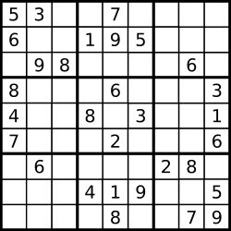
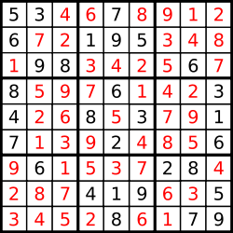
Sudoku

Slide 29
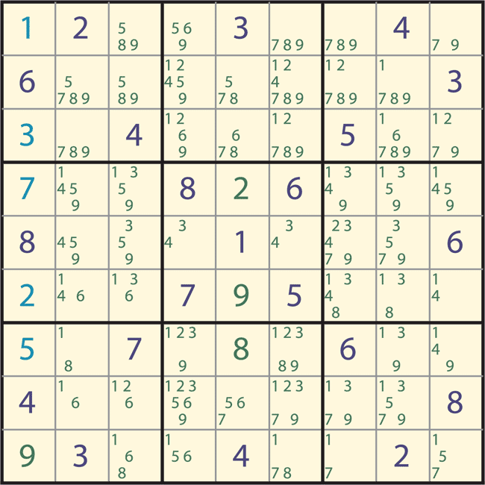
Candidate Solutions

Slide 30
Backtracking Algorithm
Overall scheme
Create a copy of the original
Search a place where there is no number entered yet
Search a number that could possibly fit
Copy the whole field and enter the number into the copy
Solve the copy (recursively)
If solving doesn't work, use the original field (not the copy) and try the next number

Slide 31
Backtracking Solver

Slide 32
Introduction to Dynamic programming
Dynamic Programming (DP) is general problem solution technique
DP can provide polynomial algorithms for seemly exponential problems
DP technique requires careful formulation: Choosing the sub-problems with sub-problem optimality
DP is a differs from recursive divide and conquer in that the sub-problems are overlap
The optimal solution is constructed from optimal solutions to all the sub-problems
In DP, the sub-problems are solved and their optimal solutions stored for reuse
By solving the characteristic DP equation in a bottom-up fashion, DP achieves efficient algorithms

Slide 33
Defining Sub-problems
Sub-problems S_{i,j}
Find the best parenthesization of
A_{o} * A₁ * ... * A_{i-1} * A_{i} * A_{i+1} * ... * A_{j} * A_{j+1} * ... * A_{n-1}
N_{i,j} = minimum number operations required for this sub-problem
The optimal solution for the original problem is N_{0,n-1}
A_{o} * A₁ * ... * A_{i-1} * A_{i} * A_{i+1} * ... * A_{j} * A_{j+1} * ... * A_{n-1}

Slide 34
Overlapping Sub-problems
Unlike Divide and Conquer, sub-problems overlap
Example:
S_{i,j}
A_{o} * A₁ * ... * A_{i-1} * A_{i} * A_{i+1} * ... * A_{j} * A_{j+1} * ... * A_{n-1}
S_{i+1,j+2}
A_{o} * A₁ * ... * A_{i-1} * A_{i} * A_{i+1} * ... * A_{j} * A_{j+1} * A_{j+2} * ... * A_{n-1}

Slide 35
Sub-problem Optimality
Sub-problem optimality principle
There has to be a final multiplication for the optimal solution
(A_{o} * A₁ * ... * A_{i-1} * A_{i} ) * (A_{i+1} * ... * A_{j} * A_{j+1} * ... * A_{n-1})
Then optimal number of ops is
N_{0,n-1} = N_{0,i} + N_{i+1,n-1} + d_{o} d_{i} d_{i+1}
The optimal solution can be defined in terms of optimal sub-problems
If the global optimum did not have these optimal sub-problems, we could define an even better “optimal” solution

Slide 36
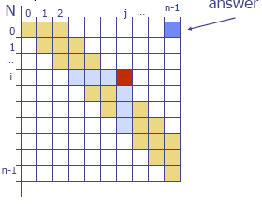
Dynamic Programming Computation
Dynamic Programming Equation
N_{i,j} = min{i ≤ k < j: N_{i,k} + N_{k+1,j} + d_{i} d_{k+1} d_{j} }
Bottom-up Computation
Efficiency: Tabulate and reuse all the intermediate values of N_{i,j}
Remember: Sub-problems overlap

Slide 37
Dynamic Programming Computation
The bottom-up construction fills in the N array by diagonals
N_{i,j} from pervious entries in i-th row and j-th column
Complexity?
Filling in each entry in the N table takes O(n) time.
Total run time: O(n³)
Actual parenthesization can be obtained by remembering the optimal k used for each N_{i,j} entry

Slide 38
Summary
Algorithm designs can be categorised along standard approaches
Brute Force Approach is widely applicable approach to algorithm design
Brute Force leads to simple algorithms
Greedy approach is a powerful technique to solve problem of finding optimal solutions
Divide and Conquer is a very general approach to solving problems and developing algorithms
Divide and Conquer splits the problem into roughly equal sized sub-problems, solves the sub-problems and merges the solutions
The important characteristic requirement of Divide and Conquer is that the sub-problems are independent

Slide 39
Summary contd.
Reduce and Conquer is an important variant of Divide and Conquer
In Reduce and Conquer, at each stage, only one of the sub-problems needs to be solved
Backtracking is a general solution technique based on enumerative search
Backtracking traverses the solution space using depth first search
On reaching a dead-end or an infeasible solution, it backtracks to the previous level
Backtracking produces simple algorithms which may however be too slow
Dynamic Programming (DP) is general problem solution technique

